Slide 1

TODAY’S AGENDA
- ABP Community News
🗣 Alper Ebicoglu
- Microsoft AI Frameworks & AI for ABP Devs 🗣 Halil Ibrahim Kalkan
- Microsoft AI Agent Framework 🗣 Engincan Veske
- ABP AI Management Module 🗣 Enis Necipoglu

Slide 2
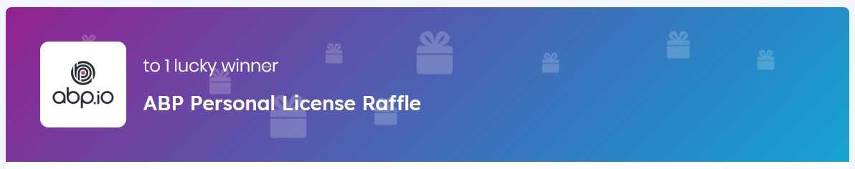
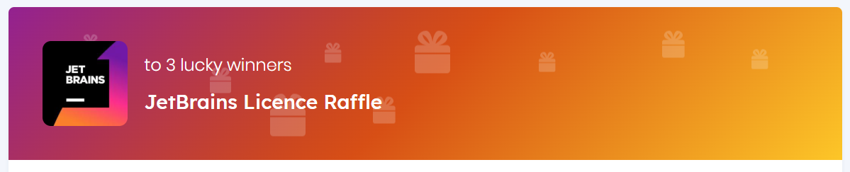
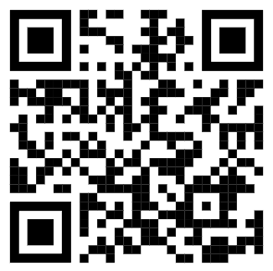
Visit abp.io/community/raffles and join the raffle for free

Slide 3

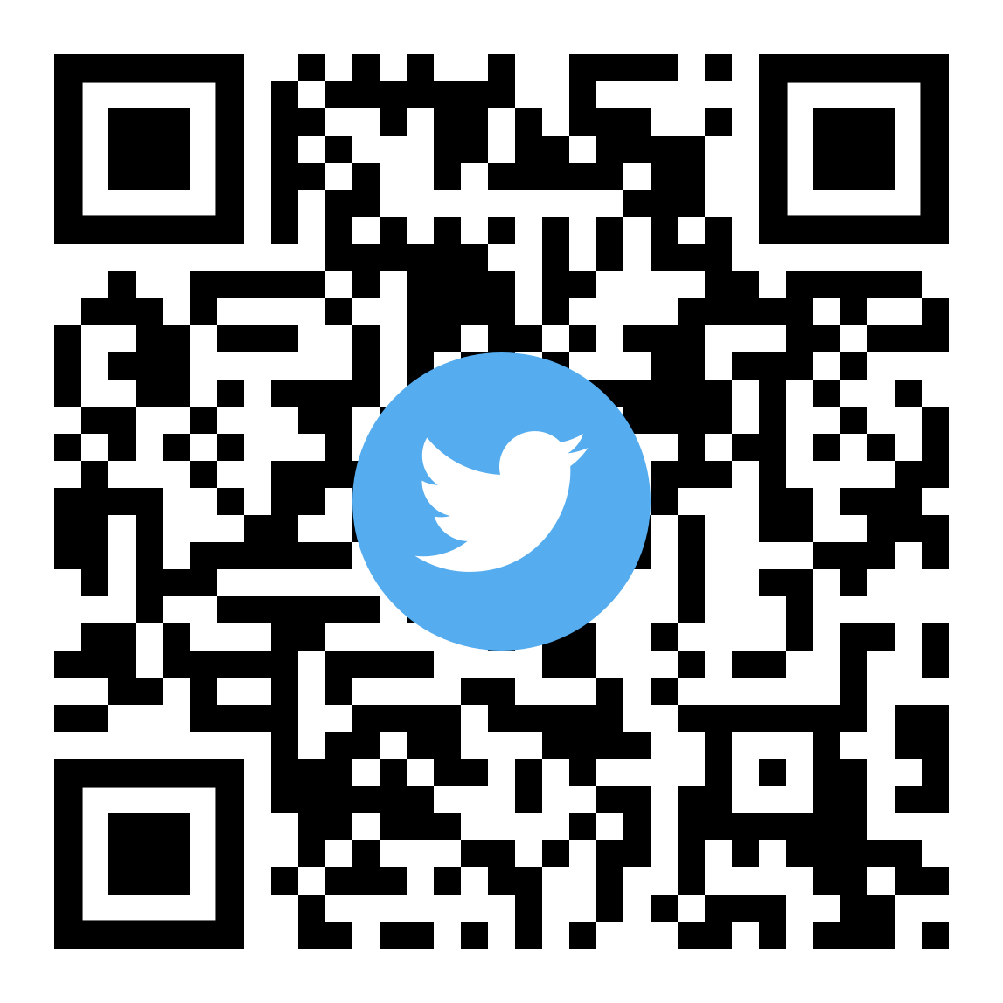

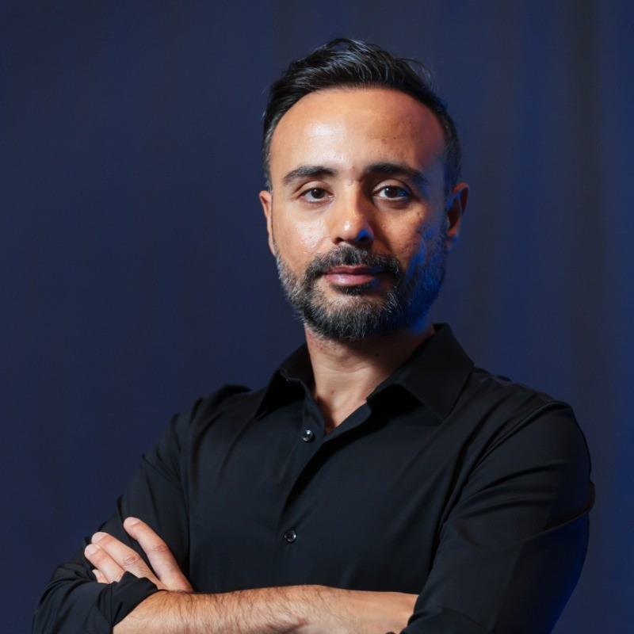




ABP
Community News
x.com/alperebicoglu
Alper EBICOGLU
github.com/ebicoglu
Co-Founder of Volosoft
linkedin.com/in/ebicoglu
alperonline.medium.com

Slide 4

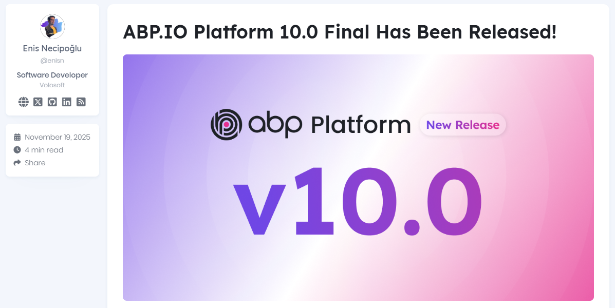
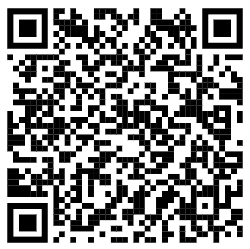
ABP now supports .NET 10
Scan to go to website

Slide 5
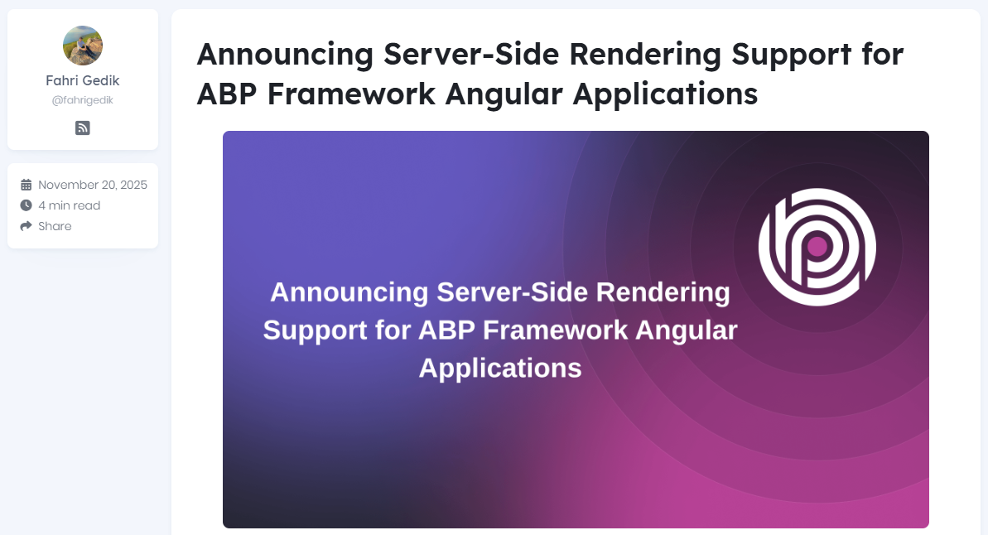
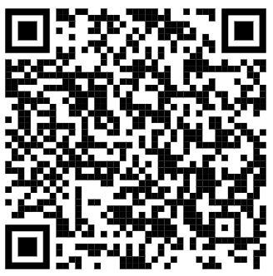
Scan to go to website

Slide 6
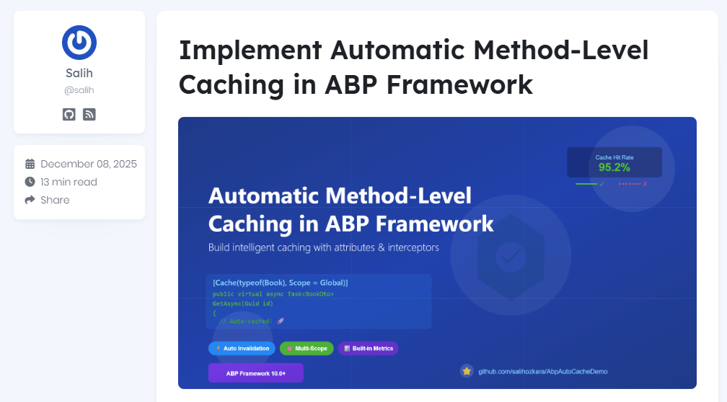
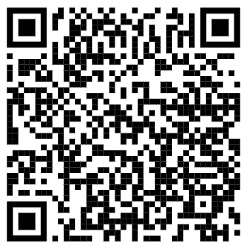
Scan to go to website

Slide 7
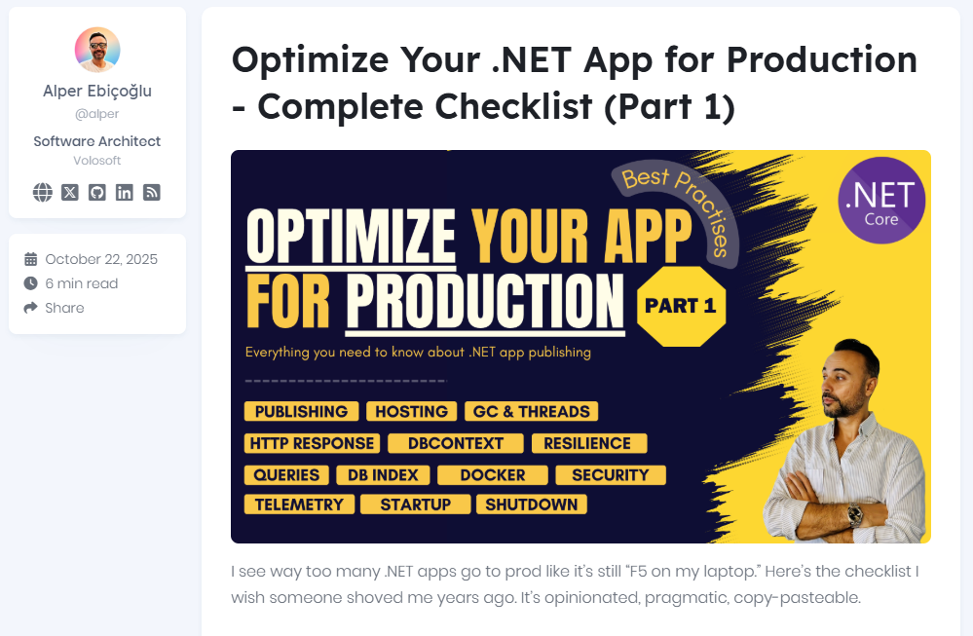
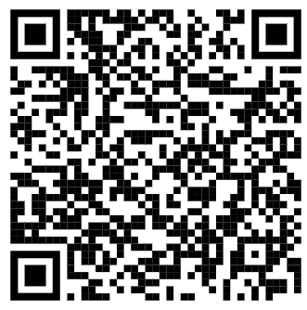
Scan to go to website

Slide 8
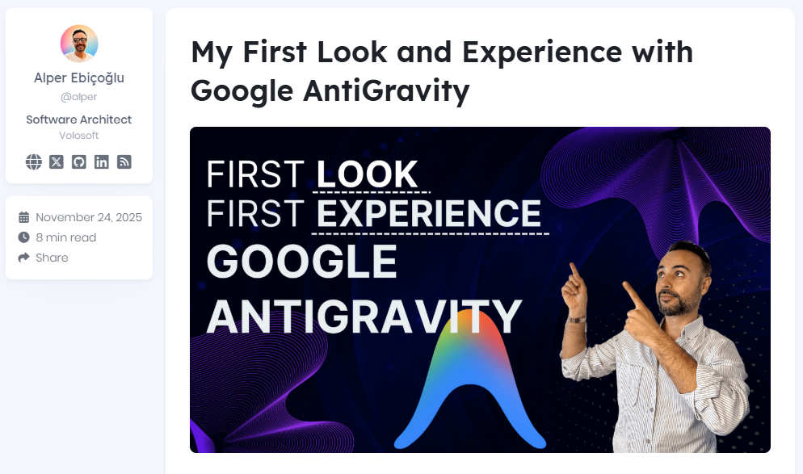
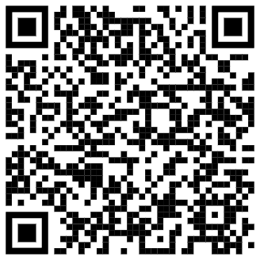
Scan to go to website

Slide 9
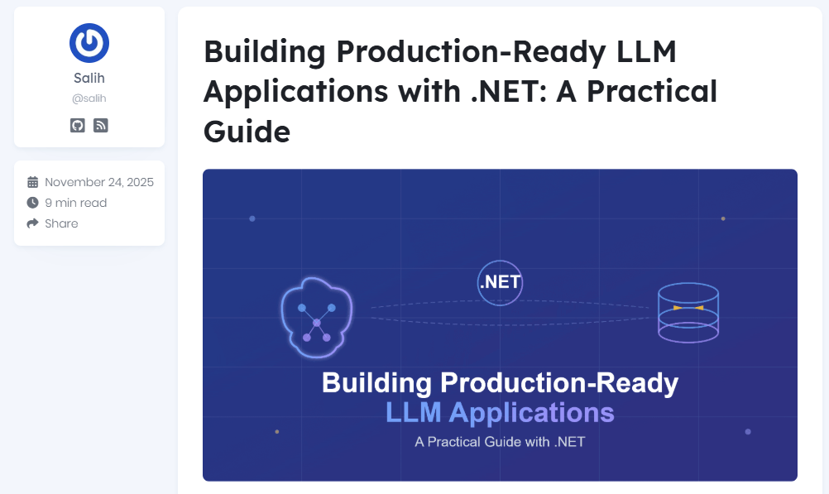
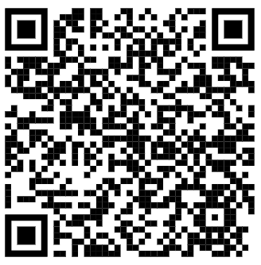
Scan to go to website

Slide 10
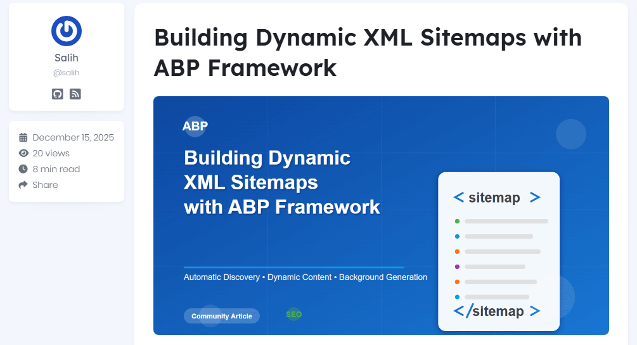
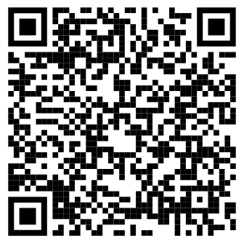
Scan to go to website

Slide 11
ABP REFERRAL PROGRAM
Who can apply?
ABP customers with past or active license holders
Reward
5% commission from total amount of purchase
Limitations (2)
1. Cannot refer your own company
2. Applies only to new purchases (not renewals)

Slide 12
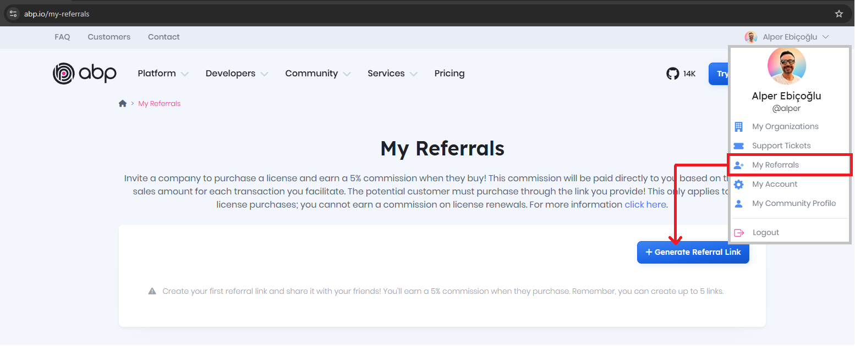
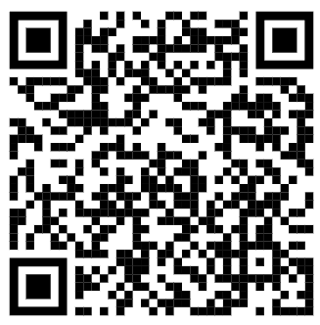
ABP Referral Program — Earn commission
Create your referral link🔗 https://abp.io/my-referrals
About this program 👉 https://abp.io/faq#what-is-the-abp-referral-system---how-does-it-work-collapse

Slide 13
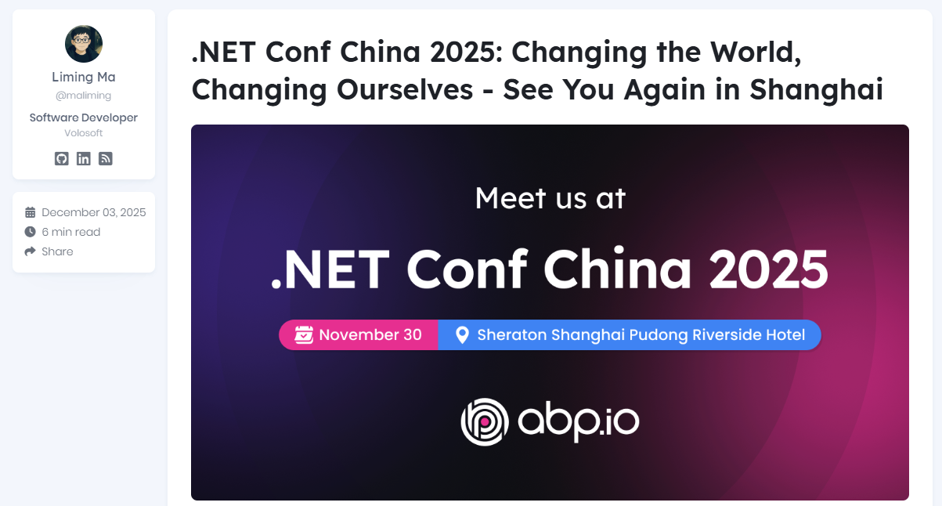
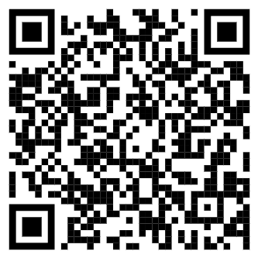
ABP was in China!
Scan to go to website

Slide 14
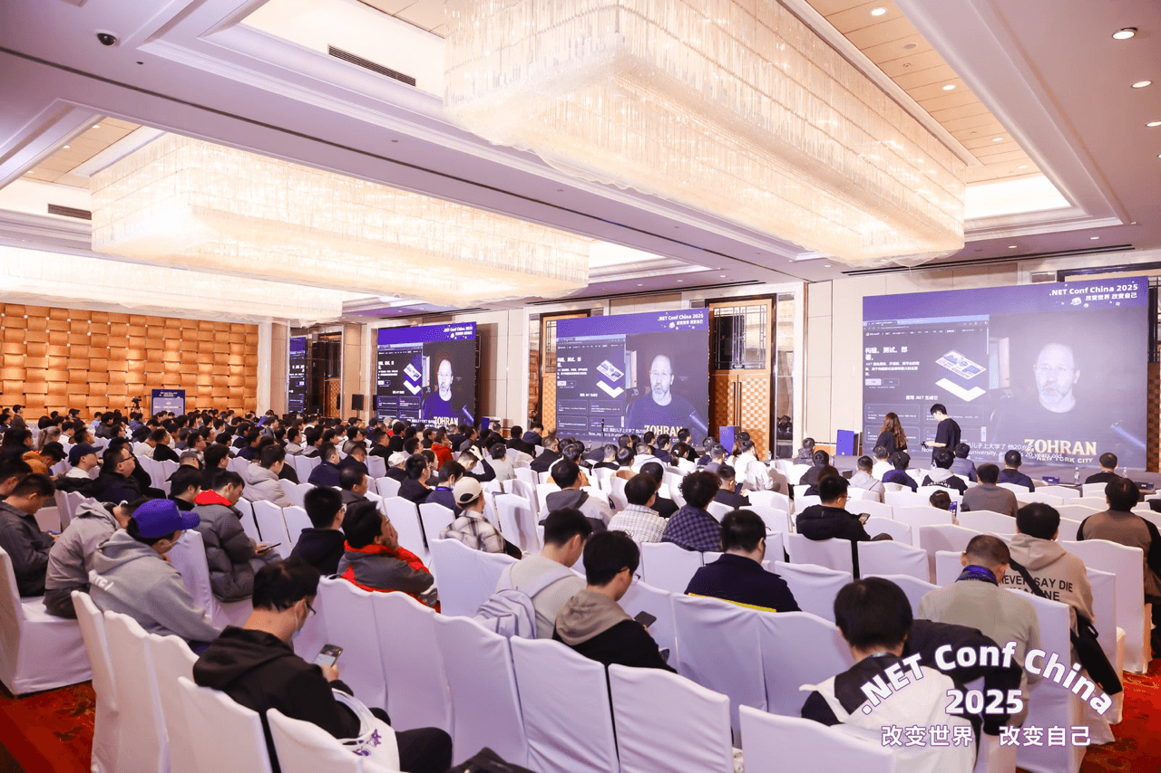

Slide 15
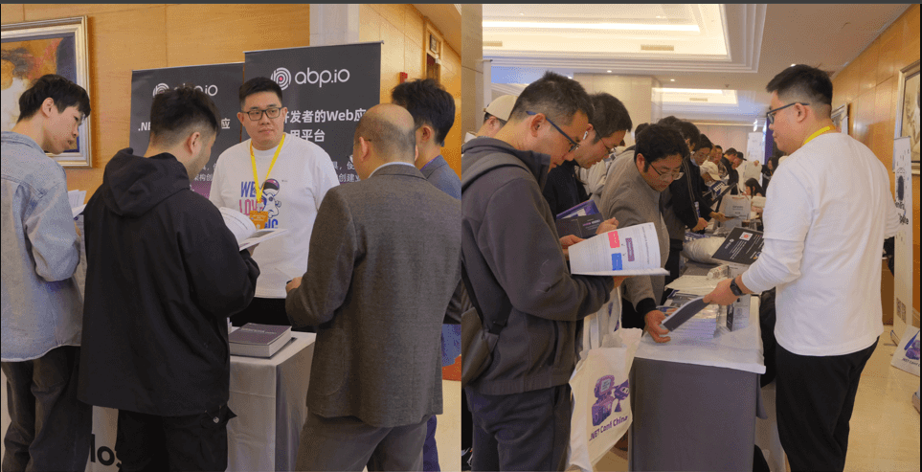

Slide 16
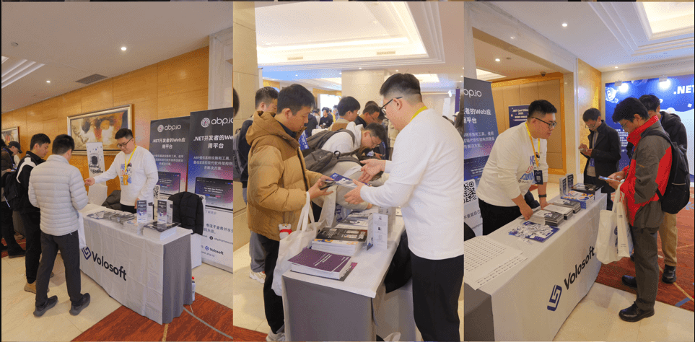

Slide 17
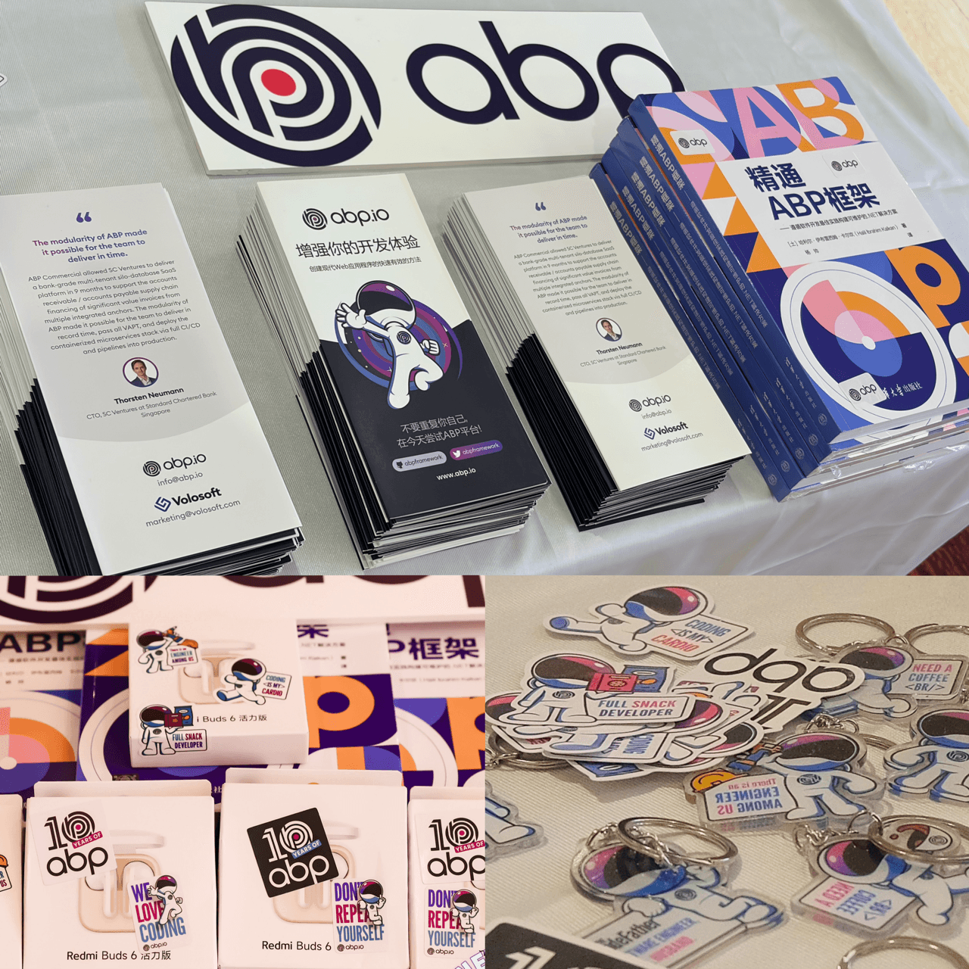

Slide 18
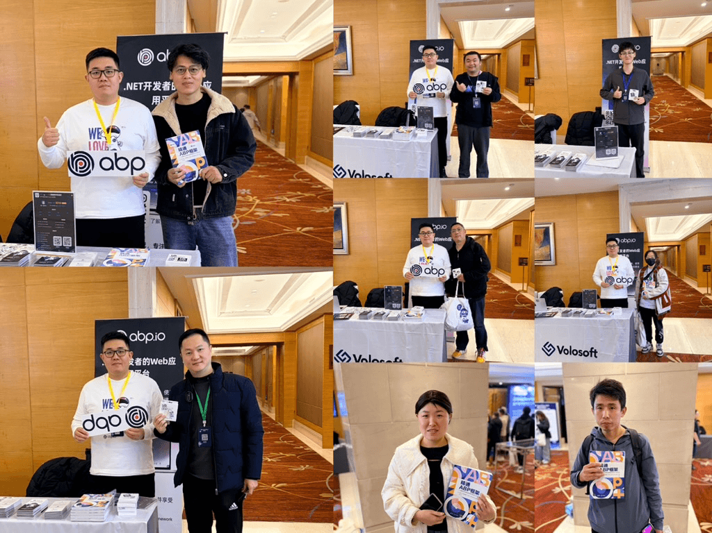

Slide 19
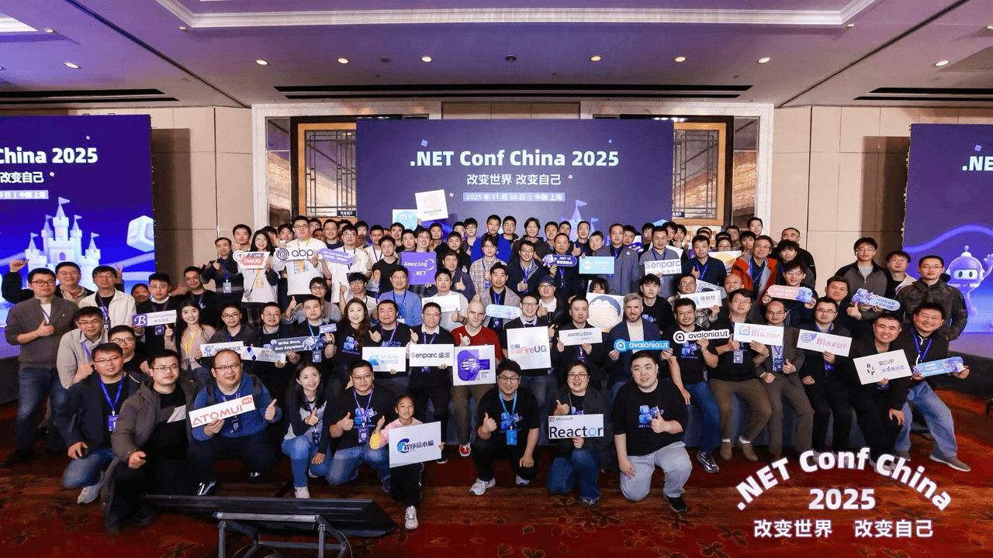

Slide 20
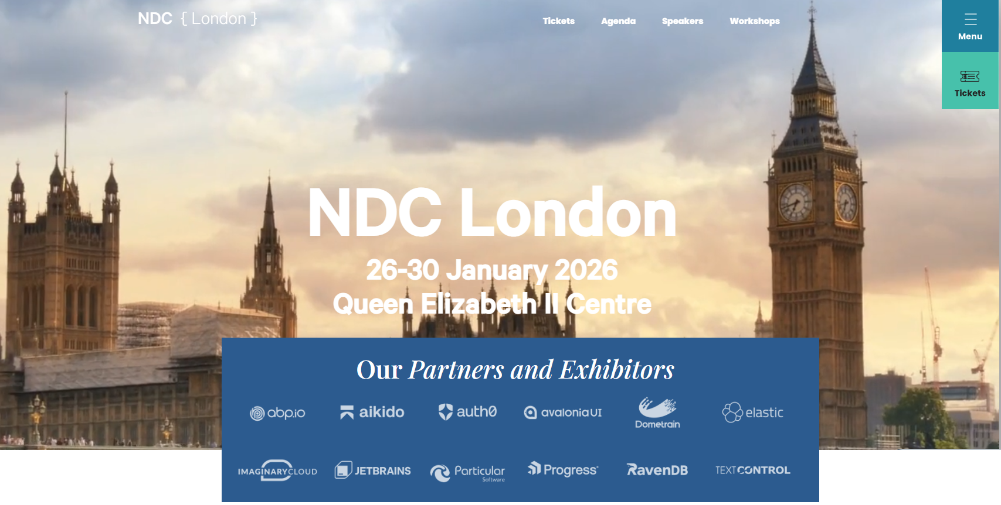
We will be in London between January 26-30, 2026

Slide 21
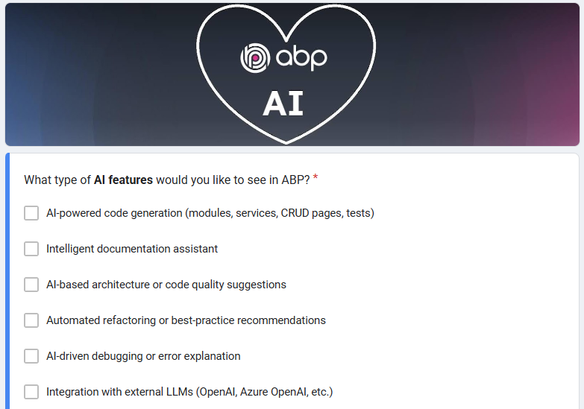
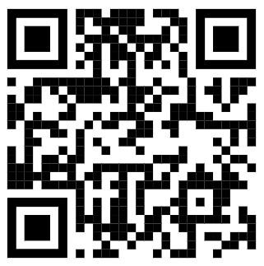
To let us know where you'd like to see AI at ABP, Please fill out our AI Feedback Form
https://forms.gle/dGkfD5eef6XLNdDp8
Scan to go to form

